Slide 1

Customer Shopping Behavior Analysis
Uncovering insights from 3,900 purchases to guide strategic business decisions

Slide 2
DATASET OVERVIEW
The Data Behind the Insights
3,900
18
50
Total Purchases
Data Columns
Locations
Key Features Analyzed
Customer demographics & subscription status
Purchase details across categories & seasons
Shopping behavior & review ratings
Discount usage & shipping preferences

Slide 3

PYTHON ANALYSIS
Data Preparation & Cleaning
01
Data Loading & Exploration
Imported dataset, checked structure with df.info() and summary statistics
02
Missing Data Handling
Imputed 37 missing Review Ratings using median by category
03
Feature Engineering
Created age_group bins and purchase_frequency_days columns
04
Database Integration
Connected to PostgreSQL for advanced SQL analysis

Slide 4
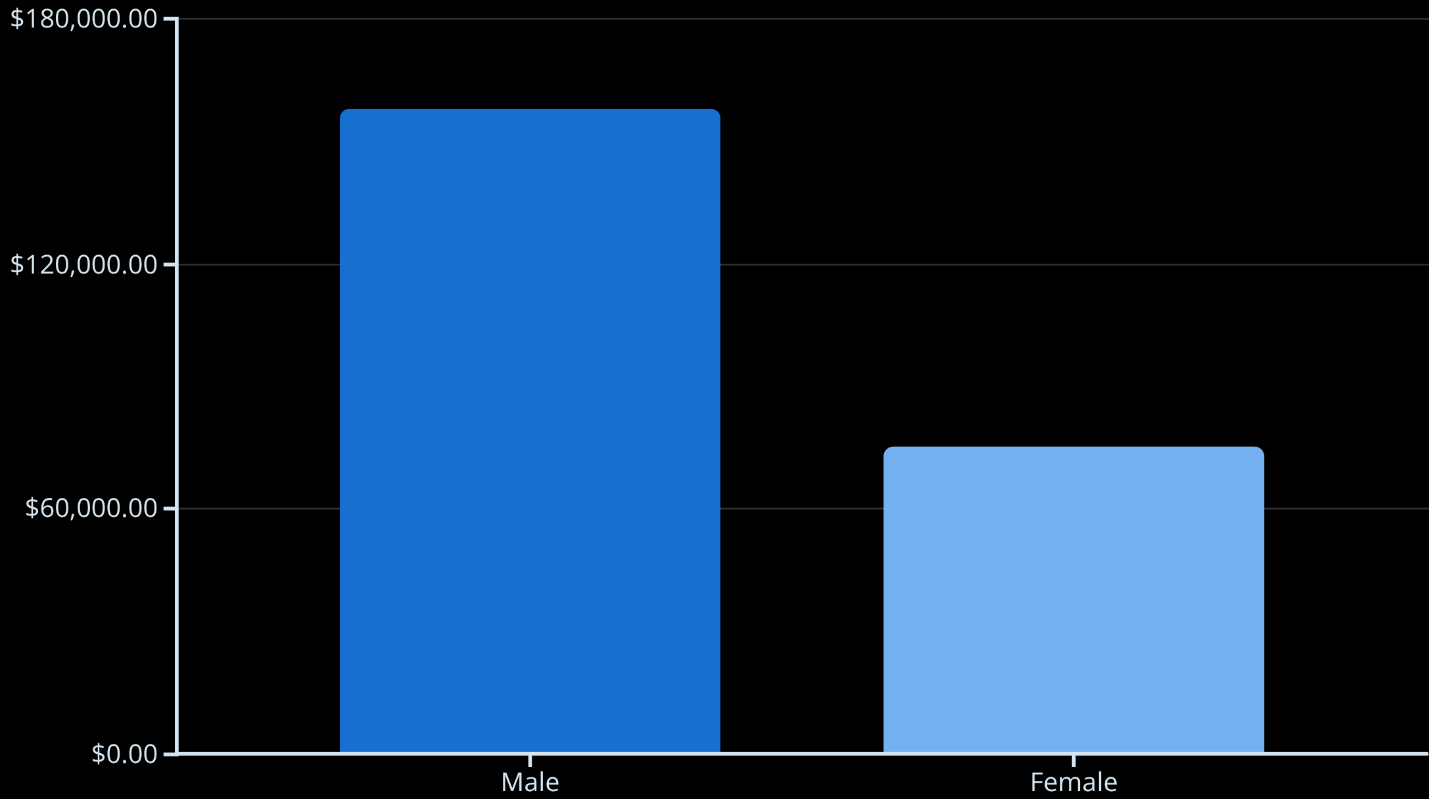
SQL INSIGHTS
Revenue by Gender
Gender Gap
Male customers generate 2.1x more revenue than female customers
839 high-spending discount users identified spending above average despite using discounts

Slide 5





Top-Rated Products
Gloves
Sandals
Boots
Hat
3.86 average rating
3.84 average rating
3.82 average rating
3.80 average rating
Skirt
3.78 average rating

Slide 6
SHIPPING ANALYSIS
Subscription vs. Non-Subscription Customers
Key Finding
Subscribers
Non-Subscribers
Non-subscribers generate 2.7x more total revenue despite similar average spend
1,053 customers
2,847 customers
$59.49 avg spend
$59.87 avg spend
$62,645 total revenue
$170,436 total revenue
Express shipping users spend $2 more on average than Standard shipping

Slide 7




Discount-Dependent Products
50%
49.66%
49.07%
Hat
Sneakers
Coat
Highest discount rate
48.17%
47.37%
Sweater
Pants

Slide 8
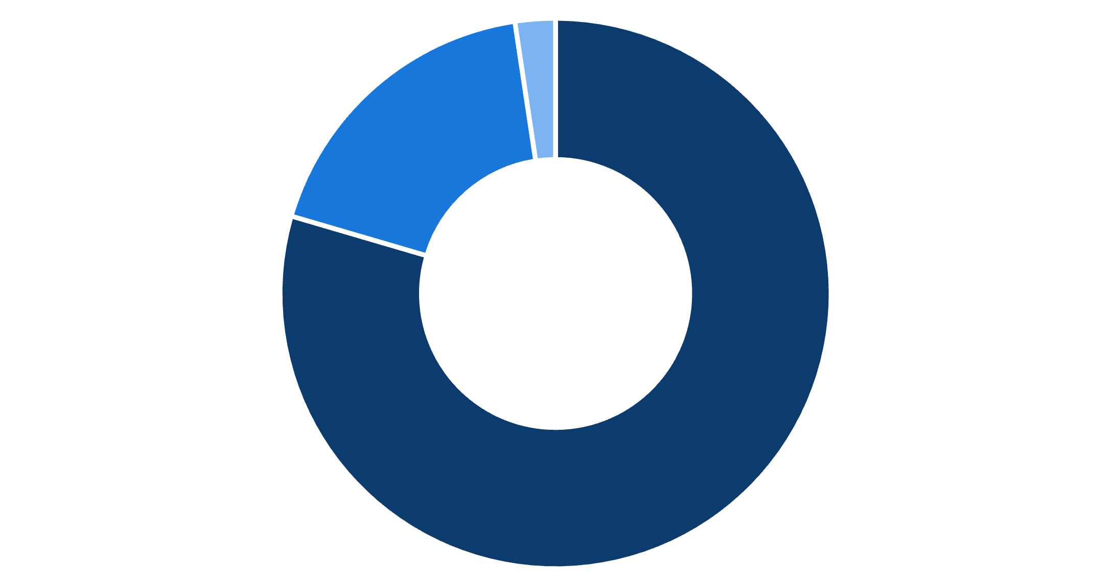
CUSTOMER SEGMENTS
Customer Loyalty Breakdown
Loyalty Dominates
80% of customers are loyal with repeat purchases
958 repeat buyers (>5 purchases) have subscriptions vs. 2,518 without
Top Products by Category
Accessories: Jewelry, Sunglasses, Belt
Clothing: Blouse, Pants, Shirt
Footwear: Sandals, Shoes, Sneakers
Loyal
Returning
New

Slide 9
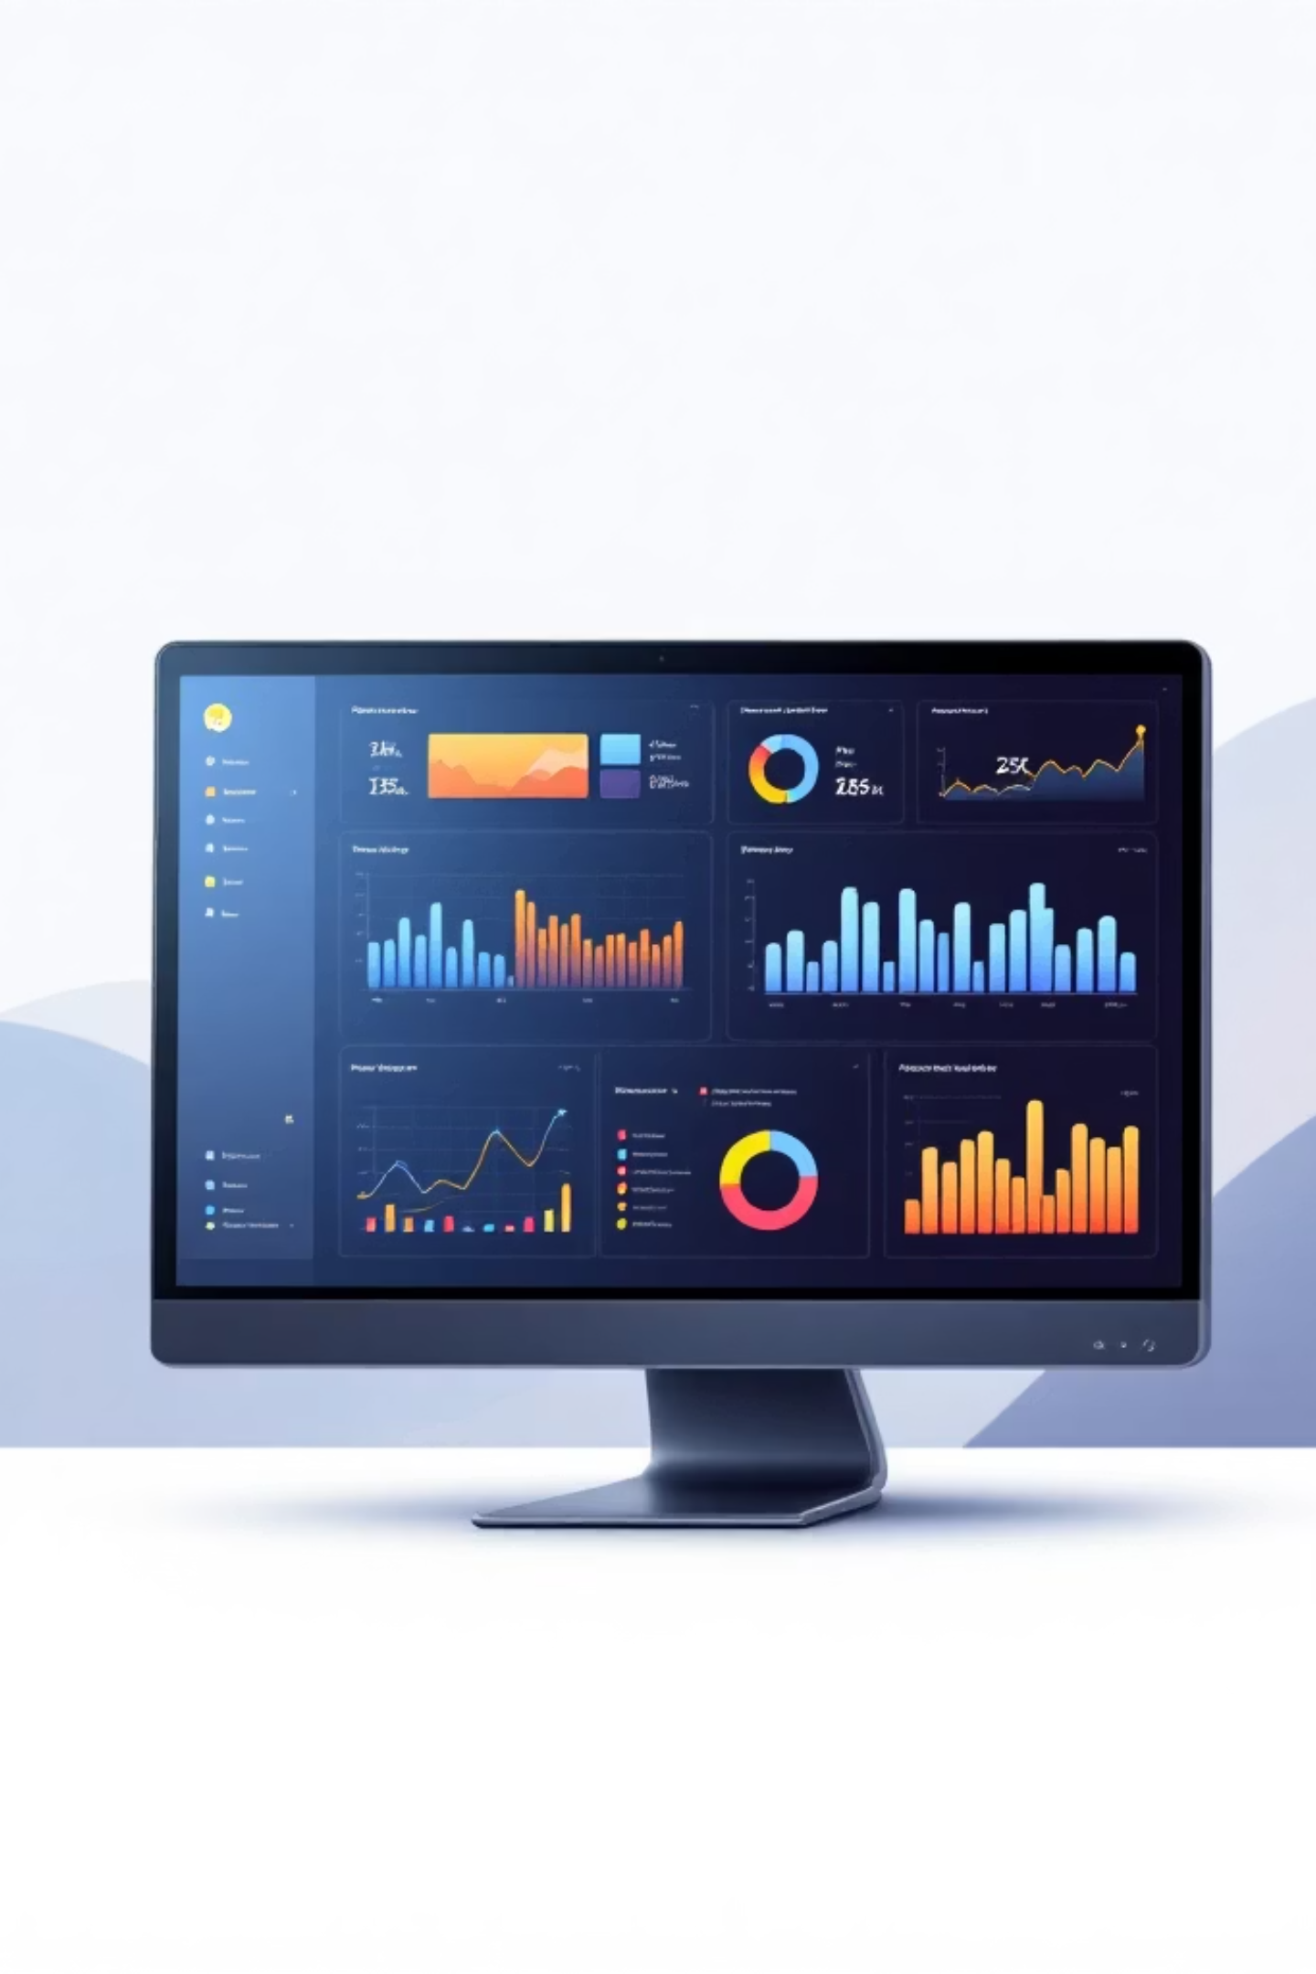
POWER BI DASHBOARD
Visual Insights at a Glance
Clothing Leads
Young Adults Drive Revenue
~$100K revenue, 1,800 sales
~$45K from top age group
27% Subscribe
Opportunity to grow subscriptions

Slide 10


RECOMMENDATIONS
Strategic Actions
1
2
3
Boost Subscriptions
Loyalty Programs
Review Discount Policy
Promote exclusive benefits to convert non-subscribers
Reward repeat buyers to strengthen loyal segment
Balance sales boosts with margin control
4
5
Product Positioning
Targeted Marketing
Highlight top-rated items in marketing campaigns
Focus on high-revenue age groups and express shipping users

